Slide 1
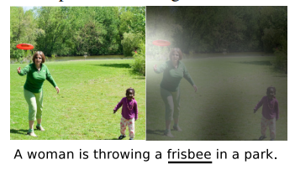
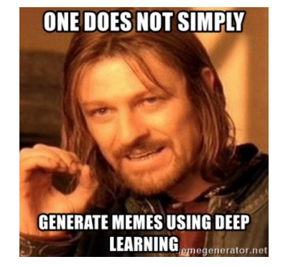
Image captioning
Why?
Scene understanding
ALTERNATIVELY
For fun

Slide 2
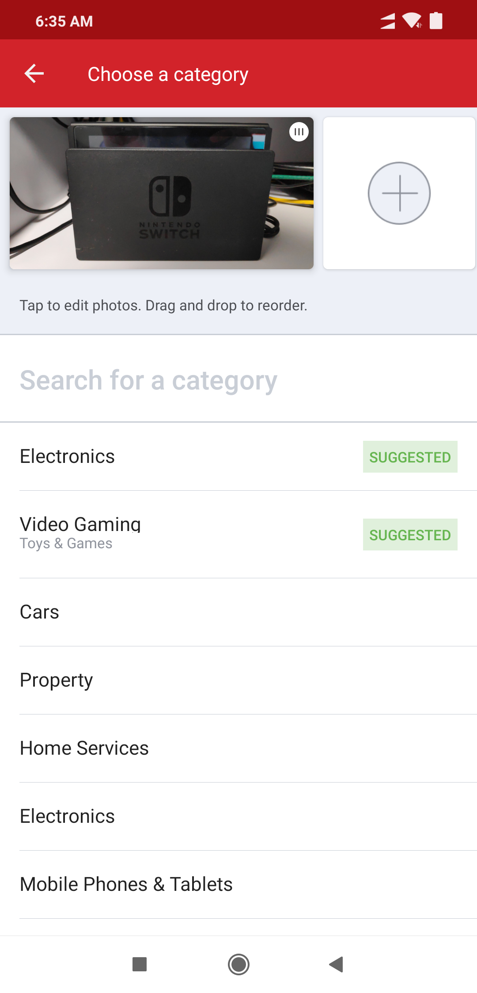
Seriously tHOUGH

Slide 3
mODEL
Based on Show, Attend and Tell
Model learns where to look
Attention mechanism

Slide 4
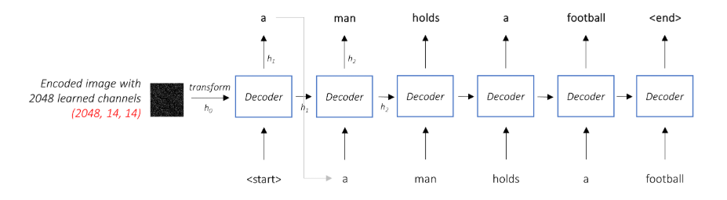
Architecture
Encoder-Decoder architecture
Show and Tell : A Neural Image Caption Generator 2014
No weighting

Slide 5
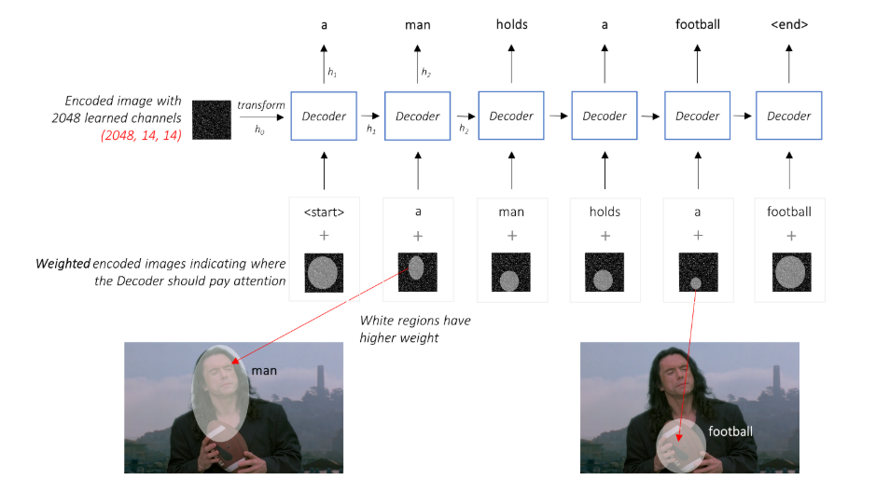
Attention
Weighted representation of the image

Slide 6
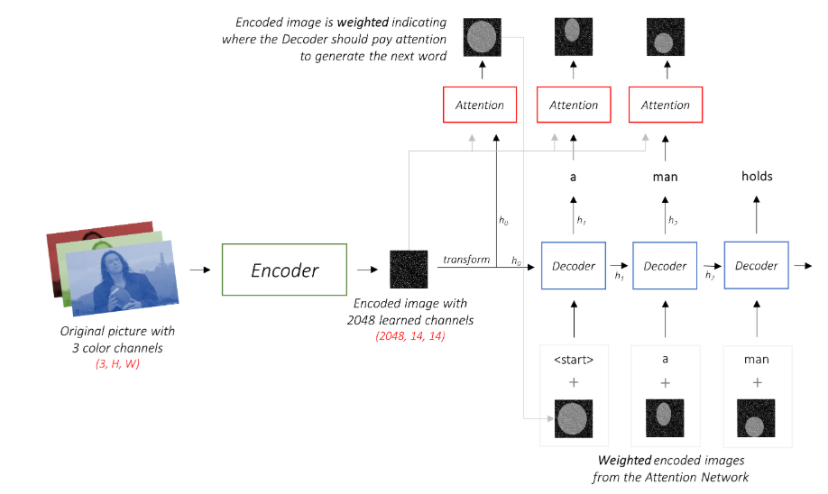
PuTTING IT ALL TOGETHER

Slide 7
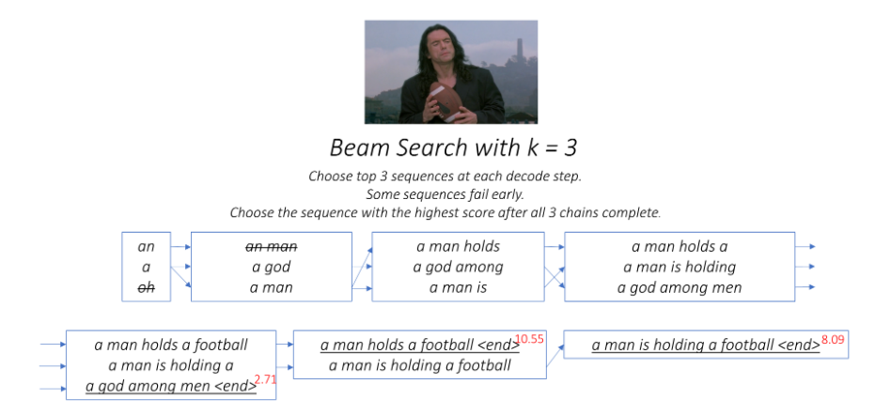
Beam SEARCH

Slide 8
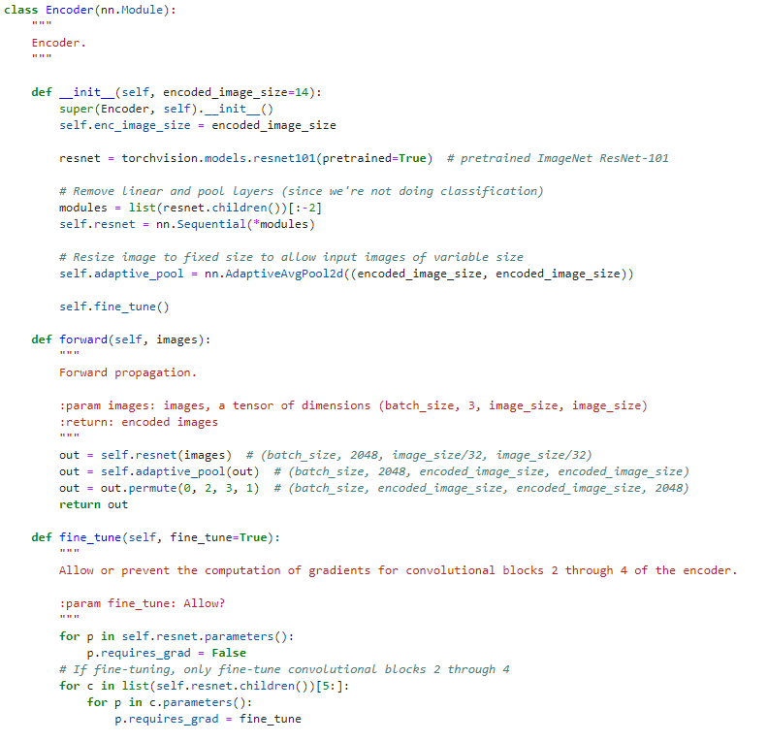
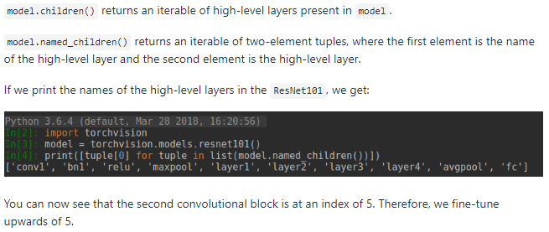
Encoder
Transfer learning
Load pretrained model
Fine-tune

Slide 9
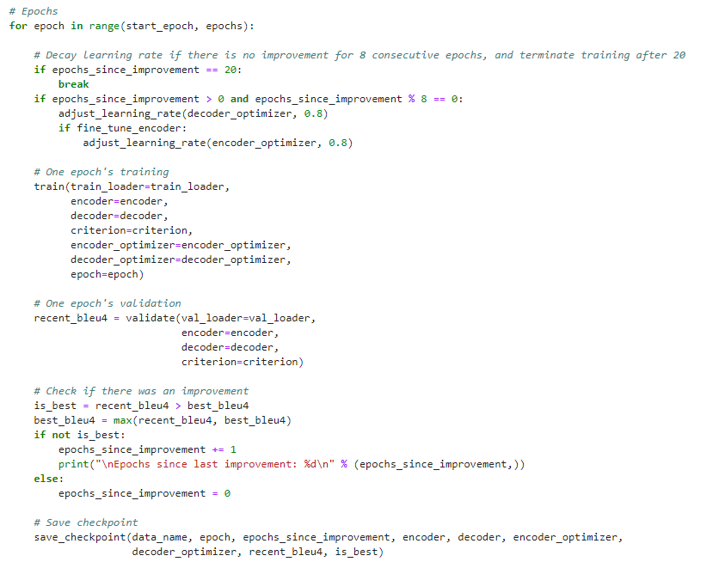
Early stopping
Authors of Show, Attend and Tell observe that correlation between the loss and the BLEU score breaks down after a point
Suggestion is to stop training when BLEU starts to degrade even if loss continues to decrease

Slide 10
What next?
Step 1) Pretrained word embeddings (Common Crawl GloVe) + fine-tune
Step 2) ???
Step 3) Profit!

